Slide 1

Freeman Chain
(Image processing)
PRESENTED BY ZHI SU AND ZHIWEI ZHANG

Slide 2
OUTLINE
Introduction of the project
What we have done
Future work

Slide 3
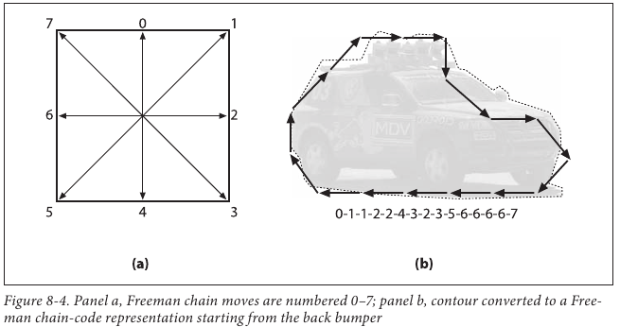
Background
What is Chain code or Freeman chain
A chain code is a lossless compression algorithm for monochrome images.
The project is aiming to process an image so that we could compress (RGB to binary) it from for transmission or storage.

Slide 4
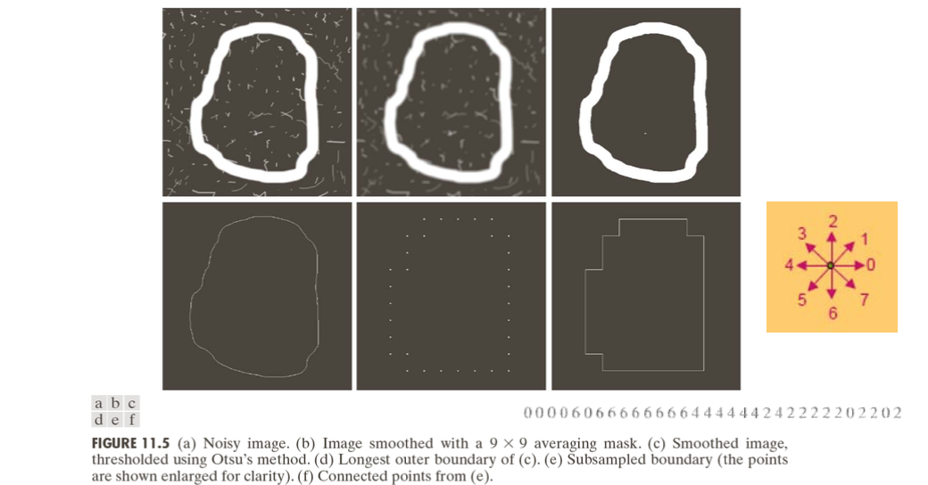
Chain code
algorithm

Slide 5
Proposed work for last presentation
1. Fully understand the problem. (Including Linear or non-linear?)
2. Learn more knowledge about Freeman chain coding and relevant algorithms.
3. Transfer the MATLAB code into C code
4. Transfer the serial codes in the noise removal, Binary image generation, the boundary subsampling, freeman code computation into parallel codes.
5. Test and improve the code using sample pictures

Slide 6
What we have done
1. Fully understand the problem. (Neither Linear or non-linear?)
2. Learn more knowledge about Freeman chain coding and relevant algorithms.
3. Transfer the MATLAB code into C code. (Only use result. Write our own code.)
4. Transfer the serial codes in the noise removal, Binary image generation, the boundary subsampling, freeman code computation into parallel codes.
5. Test and improve the code using sample pictures.
6. Get familiar with how github works, how to use branches, how to use App Atom to write and modify the script at same time.
7. Use PETSc lib to handle multiplication of matrix. (How)

Slide 7
Future work
1. Turn the following two parts: Subsampling and Freeman Chain Code into parallel codes.
2. We’ll rewrite the codes using pointer to save memory. Currently we are using struct to store values.
3. We’ll try to explore and use more build-in function instead of writing the functions ourselves.
4. Our code may not meet the requirements of all the shapes of pictures. More tests need to be carried out.

Slide 8
THANK
YOU
PRESENTED BY ZHI SU AND ZHIWEI ZHANG

